Slide 1


Off-Highway
Injury Prevention
PROTECTION & VISIBILITY
Wear a Seatbelt or Harness
Wear a Quality Helmet (full-face preferred)
Wear Safety Glasses or Goggles
Wear Sturdy Protective Clothing
  Jacket, pants, over-the-ankle boots, gloves
Wear Bright and/or Reflective Clothing
Use a Dune Flag
VEHICLE CONTROL
Speed Appropriate to the Conditions and Environment
Two Hands Steering
Avoid Distractions
Do Not Drink/Drug and Drive
GET TRAINED
There is no substitute for good training in riding, driving, navigation, preparedness, first aid, communications, or leadership.

Slide 2

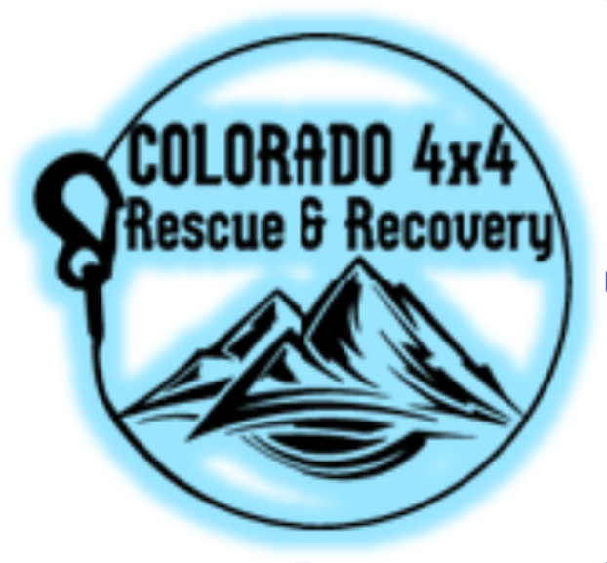

THREE RULES
Don’t Go Alone
Go Prepared
  All-Weather Clothing (all 4 seasons in one day)
  First Aid (including medications
  Fire Extinguisher (minimum 5lb ABC, 10lbs preferred)
  Survival Gear (the 10 essentials)
  Basic Repair Tools (wrenches, sockets, drivers)
  Recovery Gear
Have a Shared Plan
Tell someone you trust where you’re going, when you will be back, and who to call if you don’t return on time
TREAD LIGHTLY!
Travel Responsibly
Respect the Rights of Others
Educate yourself
Avoid Sensitive Areas
Do Your Part

