Slide 1

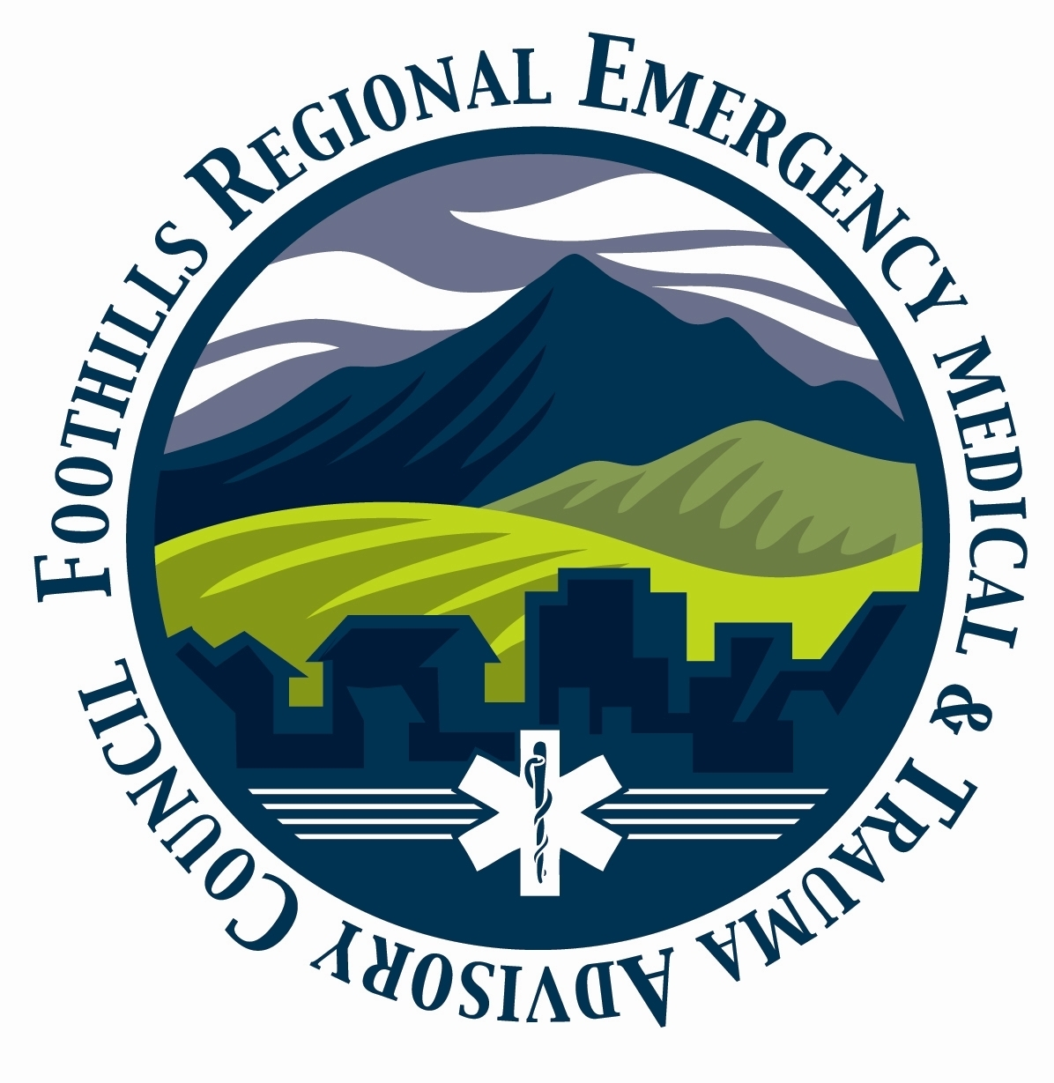


Off-Highway Injury Prevention
MOTORCYCLE/SNOWMOBILE/ATV
Wear a quality full-face helmet and/or safety glasses or goggles
Wear sturdy, protective, and bright/reflective clothing: jacket, pants, over-the-ankle boots, gloves – dress for a crash, not just a ride
Use headlights day and night
Use a dune flag
Do not carry a passenger on a single-rider ATV. Do not carry more than one passenger on a two-seater ATV.
Wear layers of clothing to keep warm and dry
Avoid riding in/on streams, rivers, and lakes
Carry and train in the use of an avalanche beacon
UTV
Wear a harness or seatbelt
Wear a quality helmet and/or safety glasses or goggles
Keep arms and legs inside
Use headlights and running lights day and night
Use a dune flag
THREE RULES
Don’t Go Alone
Go Prepared
All-weather clothing (all 4 seasons in one day)
First Aid (including medications
Fire Extinguisher (minimum 5lb ABC, 10lbs preferred)
Survival Gear (the 10 essentials)
Basic Repair Tools(wrenches, sockets, drivers)
Recovery Gear
Have a Shared Plan
Tell someone you trust where you’re going, when you will be back, and who to call if you don’t return on time
Travel Responsibly
Respect the Rights of Others
Educate yourself
Avoid Sensitive Areas
Do Your Part
ALL VEHICLES
Two hands steering at all times
Minimize distractions – loud music, radios, passengers, pets
Maintain speed appropriate for the conditions and the environment
Avoid riding or driving in the blind spots of other vehicles
Constantly scan for changing conditions
Give space between vehicles to react to changing conditions
Use proper hand signals and yield right of way when appropriate
Only ride on designated trails
Properly load the vehicle and secure the load
Do not drink/drug and drive
GET TRAINED
There is no substitute for good training! Take a safety course or driving class, and learn about navigation, preparedness, recovery, field repair, first aid, communications, leadership.

Slide 2
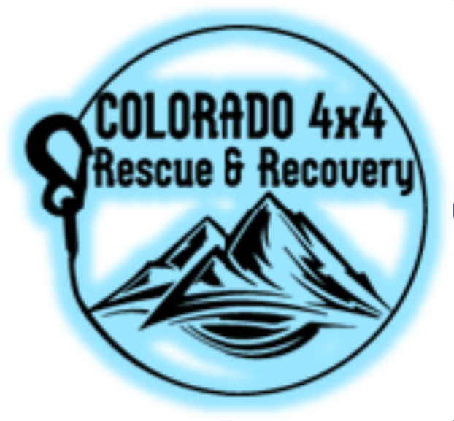

Off-Highway Injury Prevention
TRAIL RESEARCH
Beginning, end, obstacles
Last food, fuel, water, cellular
Weather for next 72 hours
VEHICLE INSPECTION
Air filter
Battery connections and charge
Belts, bushings, ball joints
Brakes and pads
Chassis, rack, bumper bolts
Fuel and fluid levels
Fluid drips or leaks
Headlamps and marker lights
Owners manual
Throttle and cables
Tires (including spare)
Wheel lug bolts
Winch, winchline, and controller
BASIC RECOVERY GEAR
Gloves
Shovel
Traction Boards
Recovery Rope
Hard & Soft Shackles
Hitch Receiver Shackle
Pulley Block
Tree Saver
FIRST AID
Trauma
Tourniquet
Trauma dressing
Triangle bandage
Boo Boos
Bandaids
Alcohol swabs
Antibacterial (Neosporin)
Gauze pads
Tape
Moleskin
Medications
OTC ibuprofen
Aspirin
Antihistamine
Antiemetic
Electrolytes
Personal meds for several days
Severe allergy meds
Glucose
Training
Stop the Bleed
First Aid / CPR / AED
Wilderness First Aid
Wilderness First Responder
THE TEN ESSENTIALS
Shelter & Warmth
Water & Food
Headlamp and Flashlight
Spare batteries/charger
Sun protection
First aid
Knife/Multitool
Fire starting tools & materials
Communications
Maps and compass
TOOLS
Air down/up tools
Basic hand tools
Basic OBDII scanner
Basic voltage meter
Battery booster / portable charger
Gloves (mechanic & nitrile)
Spare fuses and relays
Spare parts
Tire changing tools
Tire repair kit
Work light

